Slide 1

Image processing sections

Slide 2
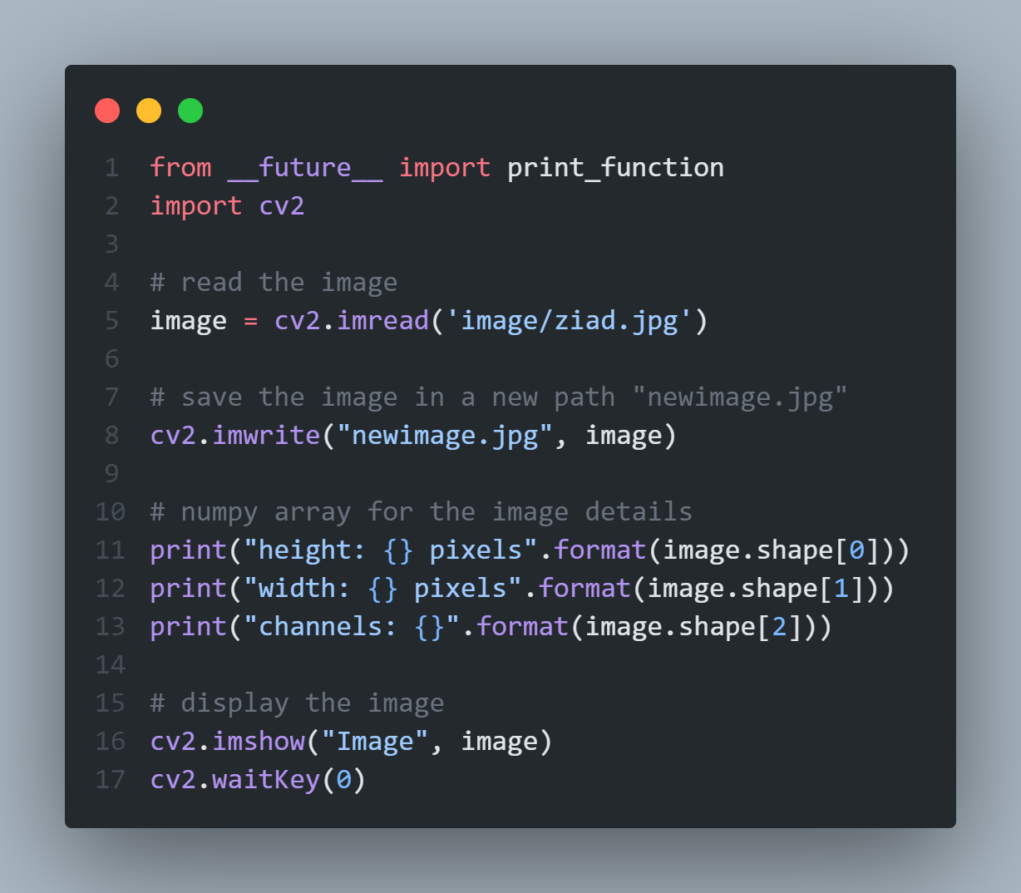
Chapter 3

Slide 3
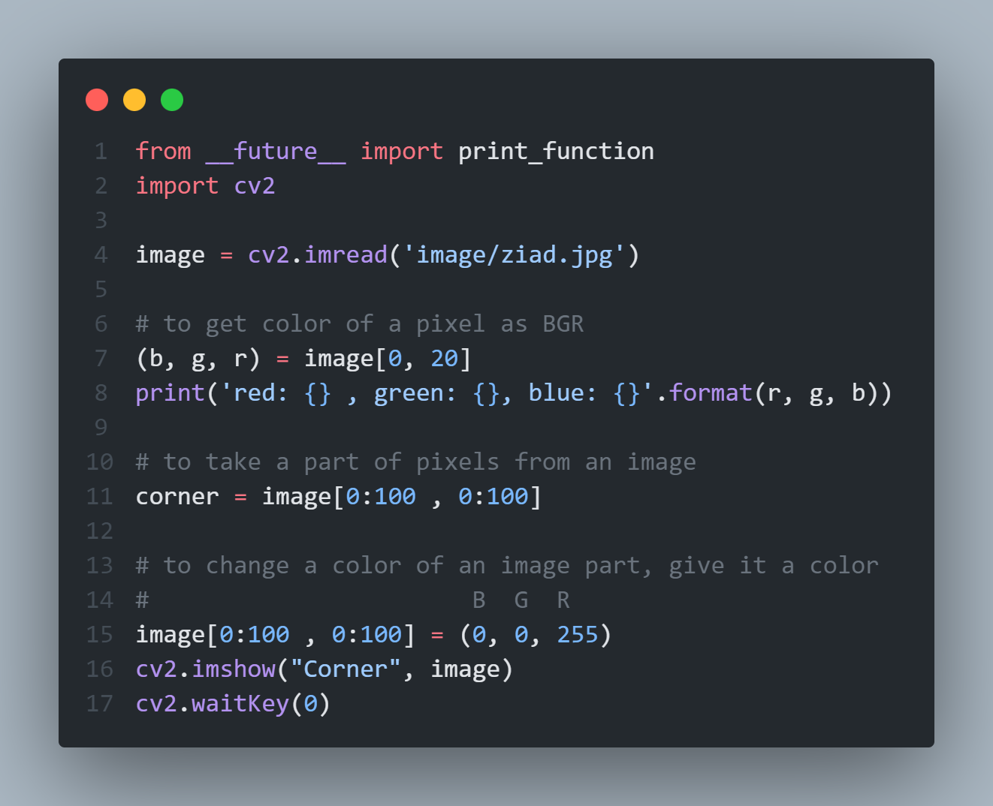
Chapter 4

Slide 4
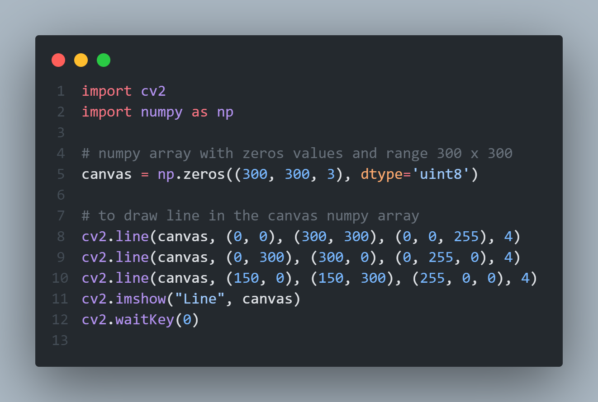
Chapter 5
- To draw line:

Slide 5
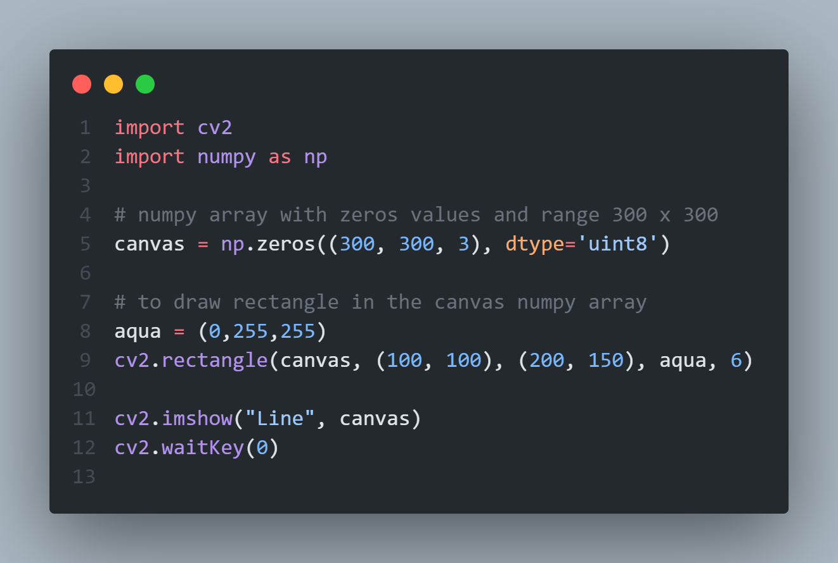
Chapter 5
- To draw rectangle:

Slide 6
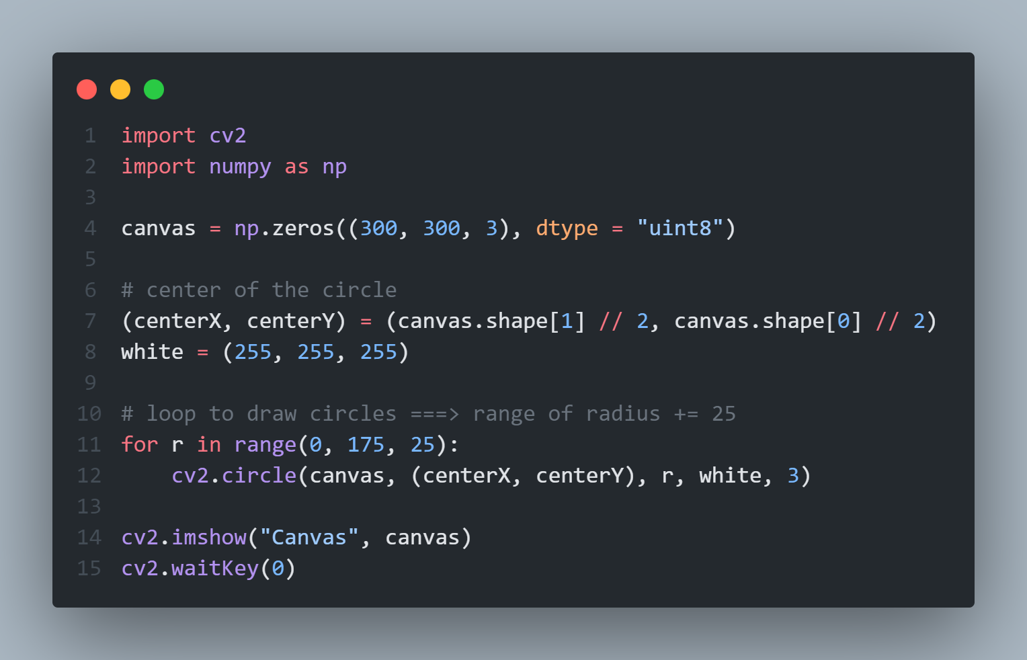
Chapter 5
- To draw circle:

Slide 7
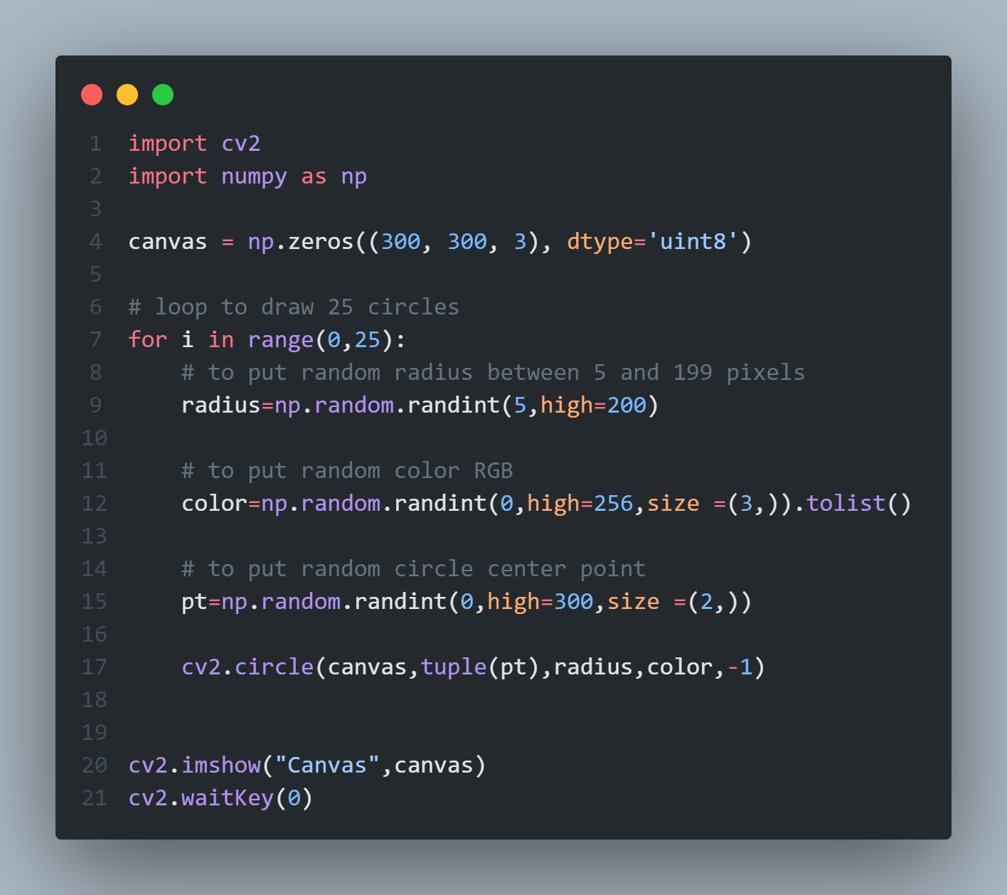
Chapter 5
- To draw random circle with random RGB and Center point:

Slide 8
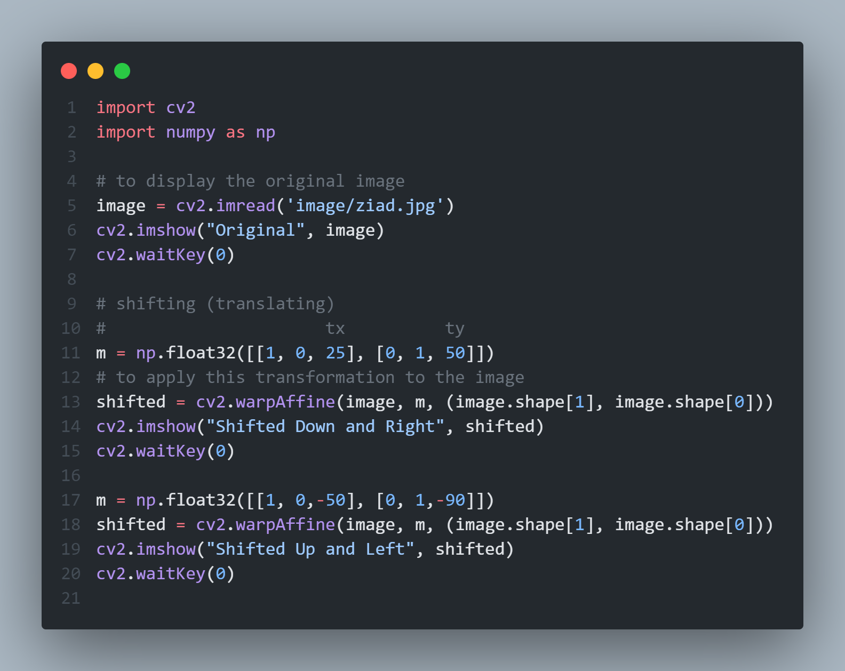
Chapter 6
To apply translation:
Negative values of tx will shift the image to the left and Positive values will shift the image to the right.
Negative value of ty will shift the image up and positive values will shift the image down

Slide 9
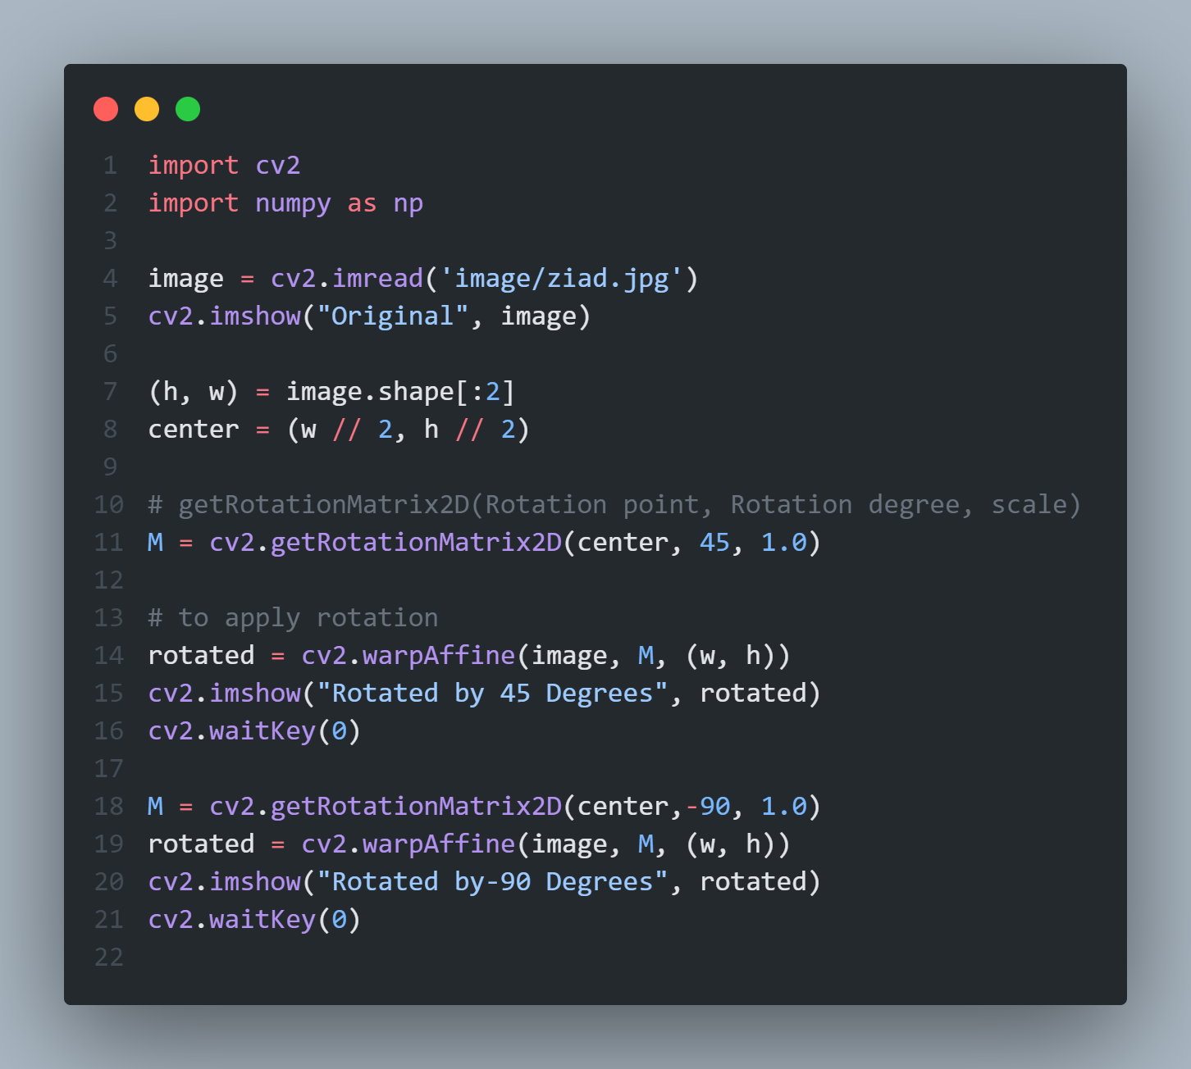
Chapter 6
To apply rotation:
The scale :
Value = 1.0: means the same dimensions of the image are used.
Value = 2.0: the image would be doubled in size.
Value = 0.5: halves the size of the image
The rotation degree:
Negative value: clockwise مع عقارب الساعة
Positive value: vise verse العكس صحيح

Slide 10
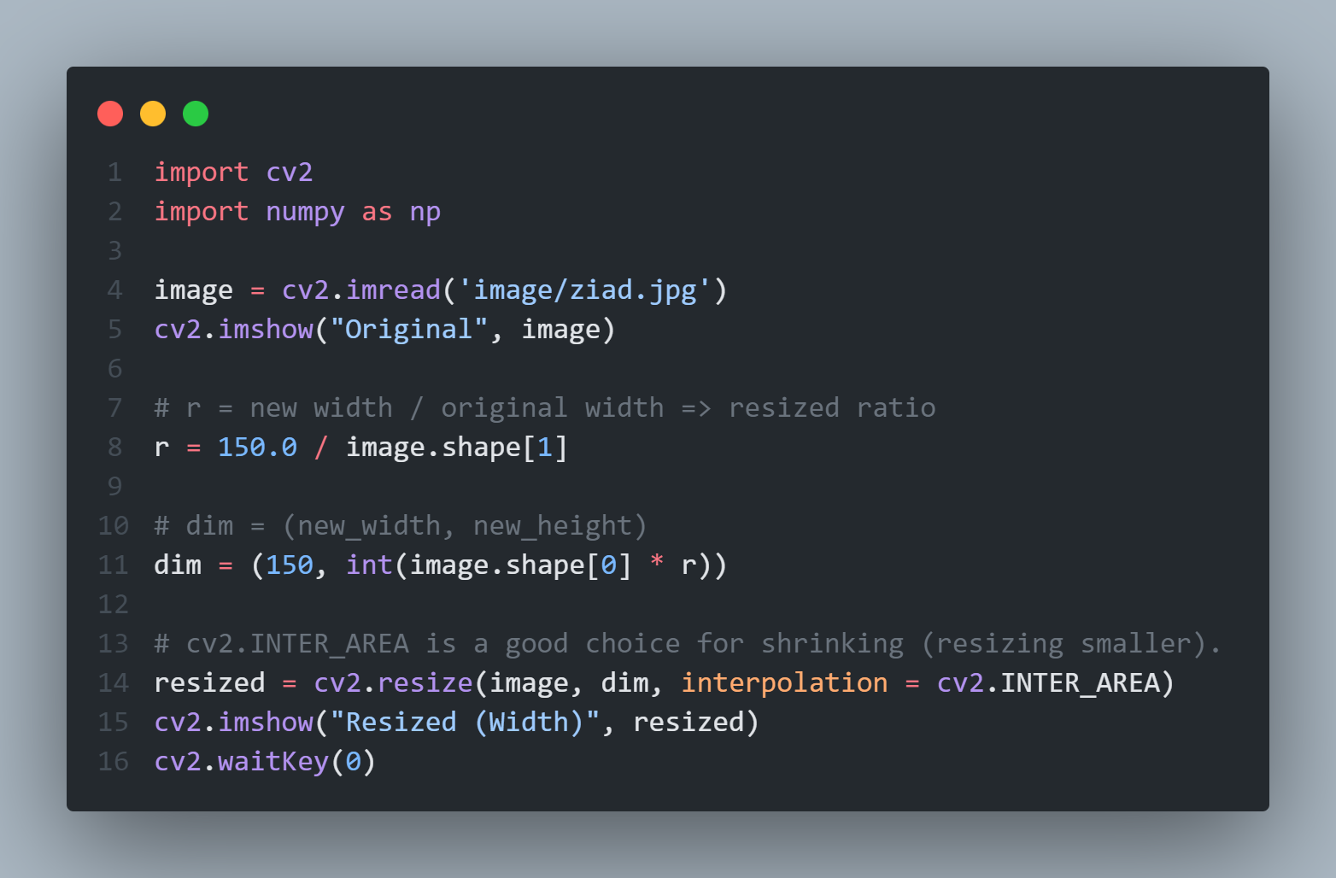
Chapter 6
- To apply resize width:

Slide 11
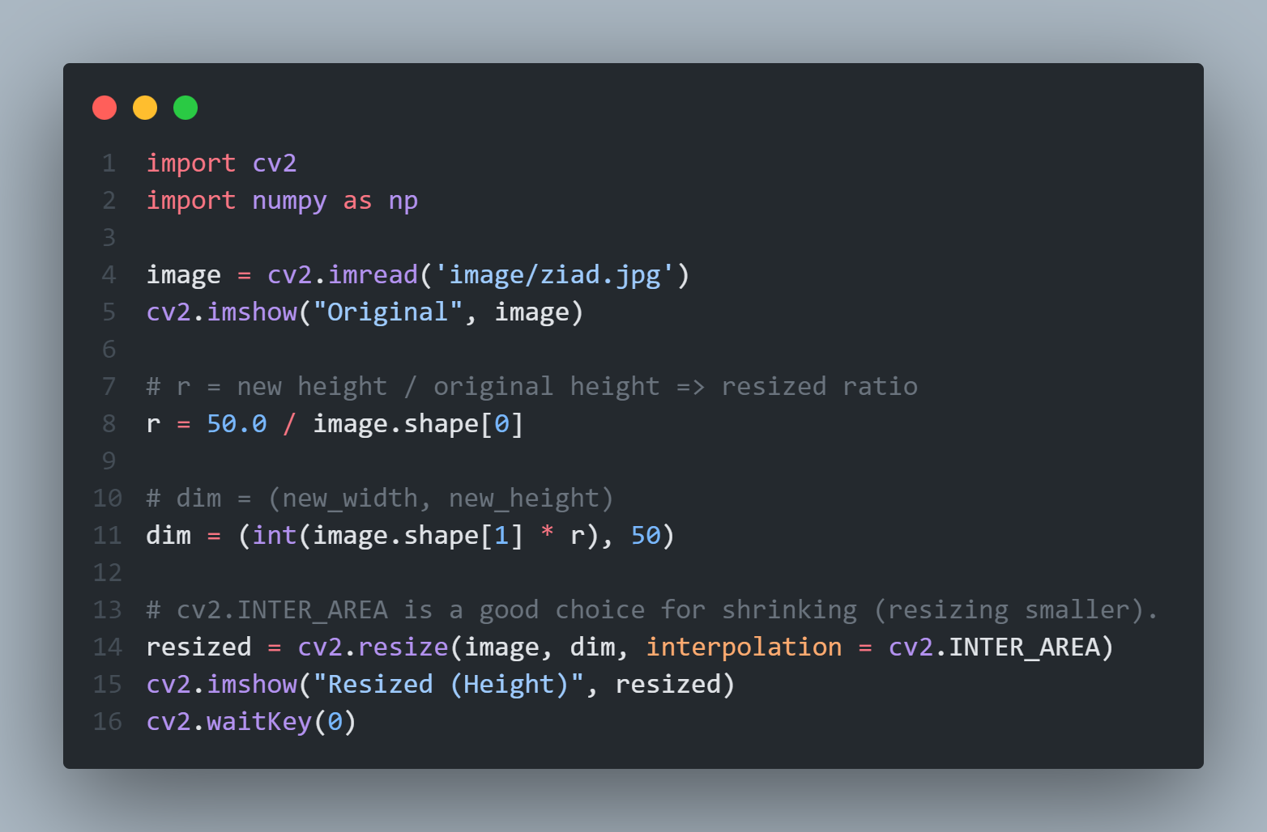
Chapter 6
- To resize height:

Slide 12
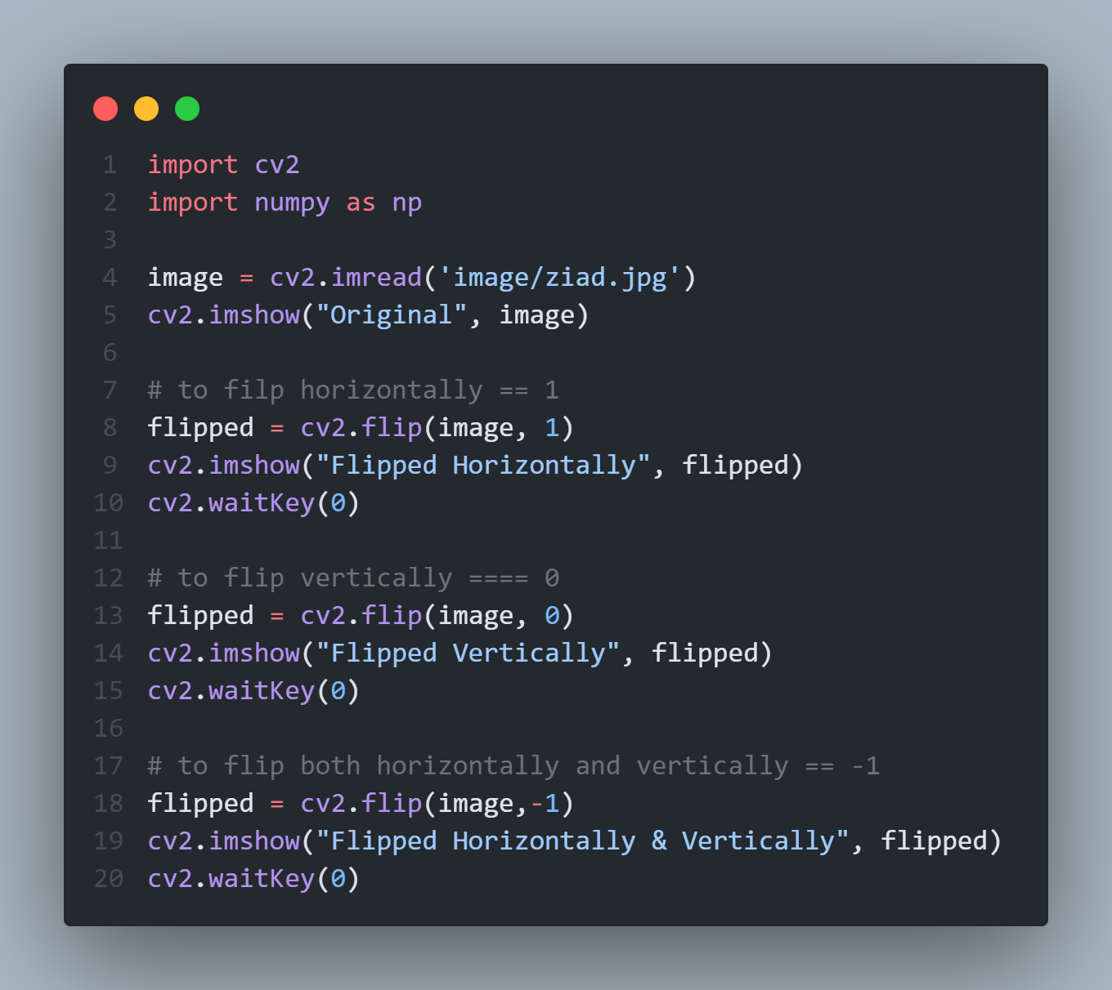
Chapter 6
- To apply flipping:

Slide 13
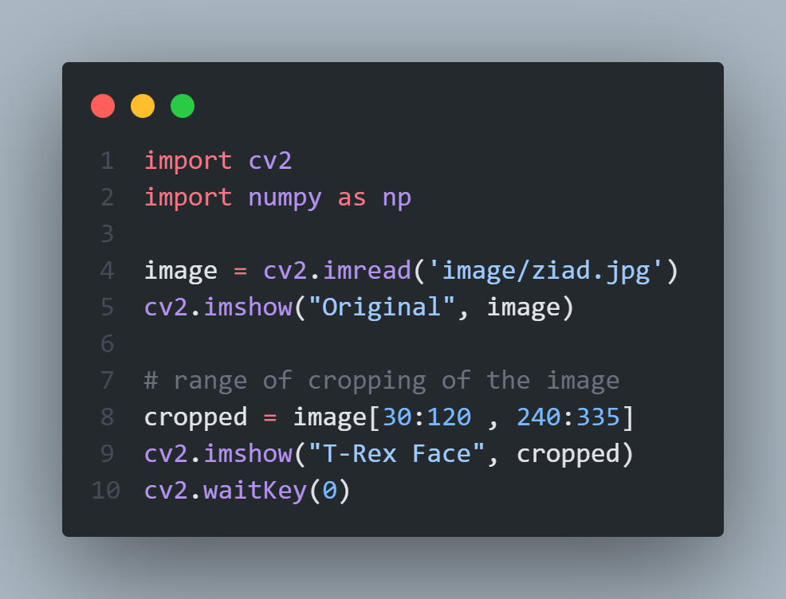
Chapter 6
cropping:
Start y: The starting y coordinate. y = 30.
End y: The ending y coordinate. y = 120.
Start x: The starting x coordinate. x = 240.
End x: The ending x-axis coordinate. x = 335.

Slide 14
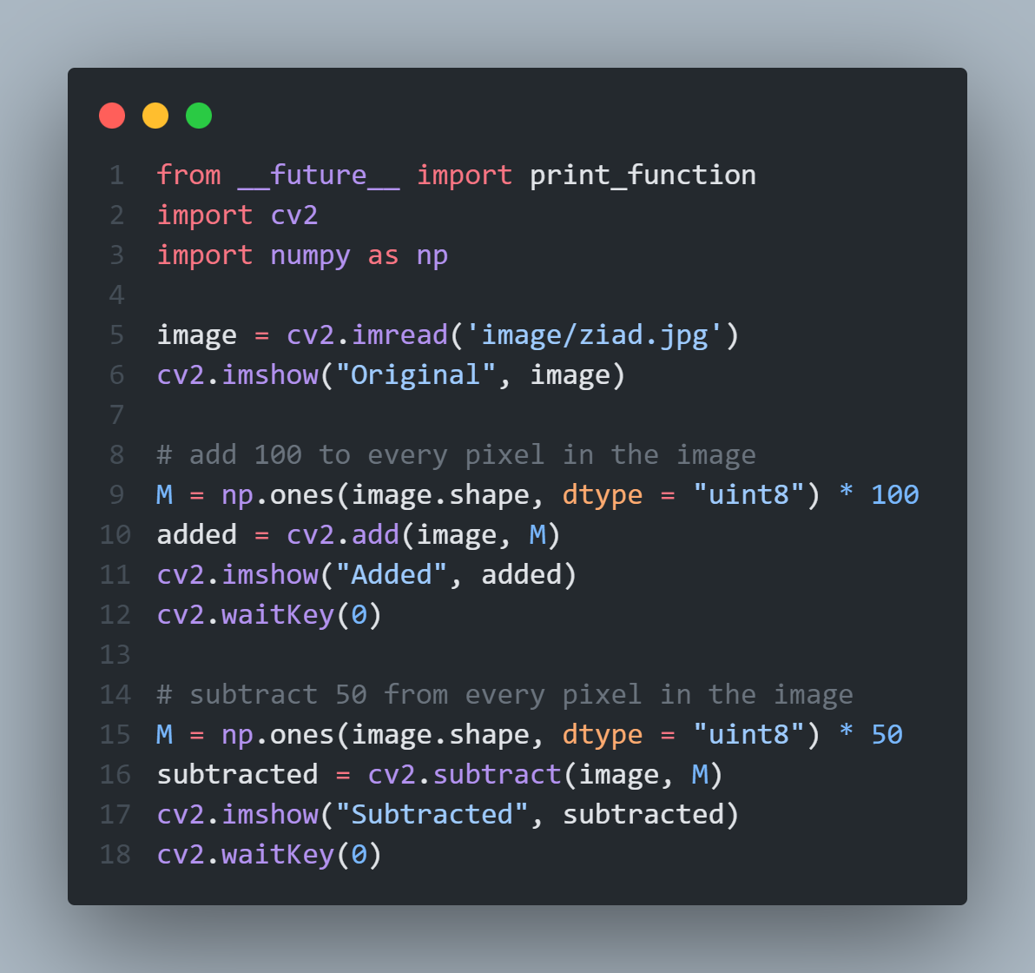
Chapter 6
- Arithmetic:

Slide 15
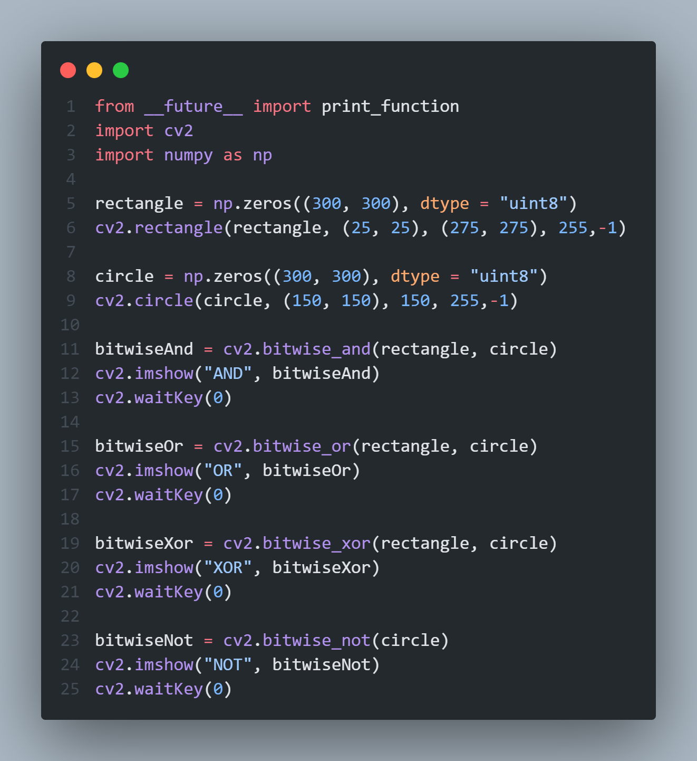
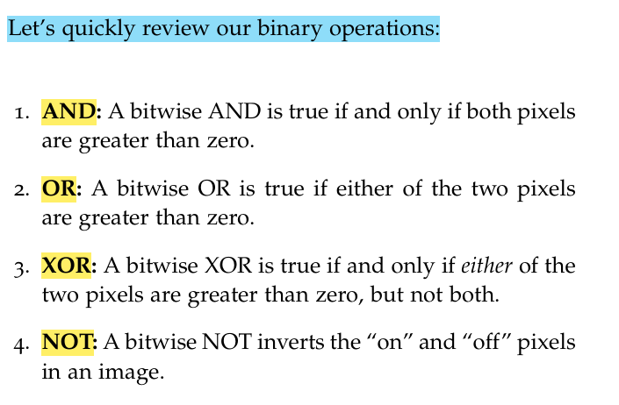
Chapter 6
- Bitwise:

Slide 16
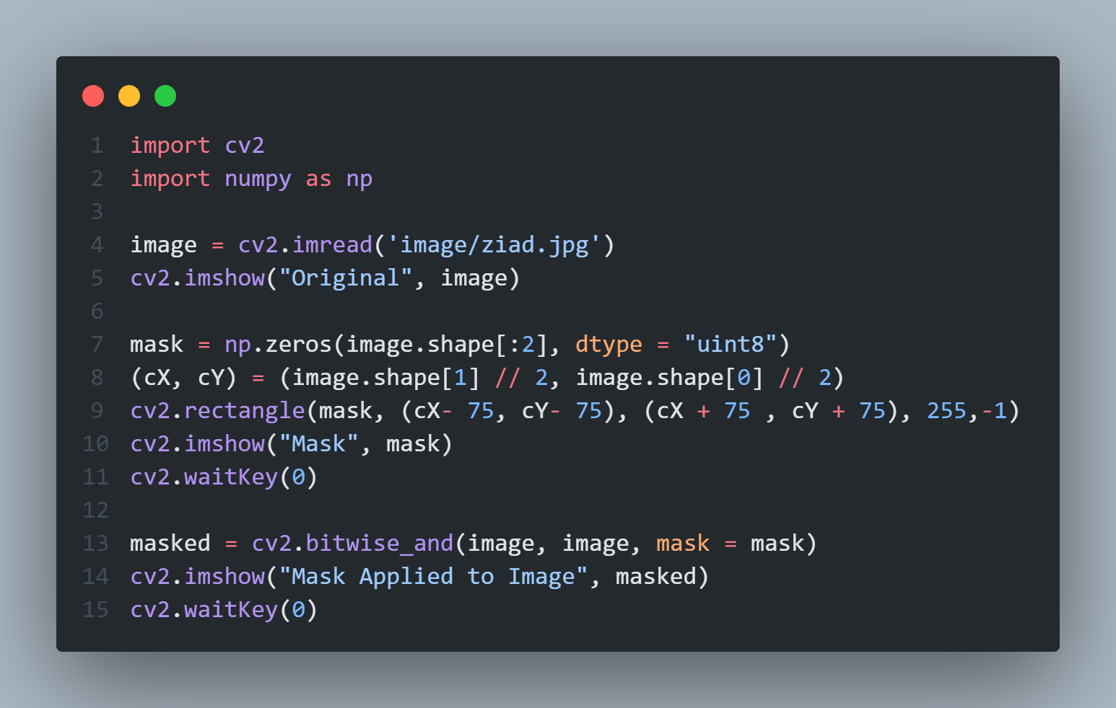
Chapter 6
- Masking rectangle:

Slide 17
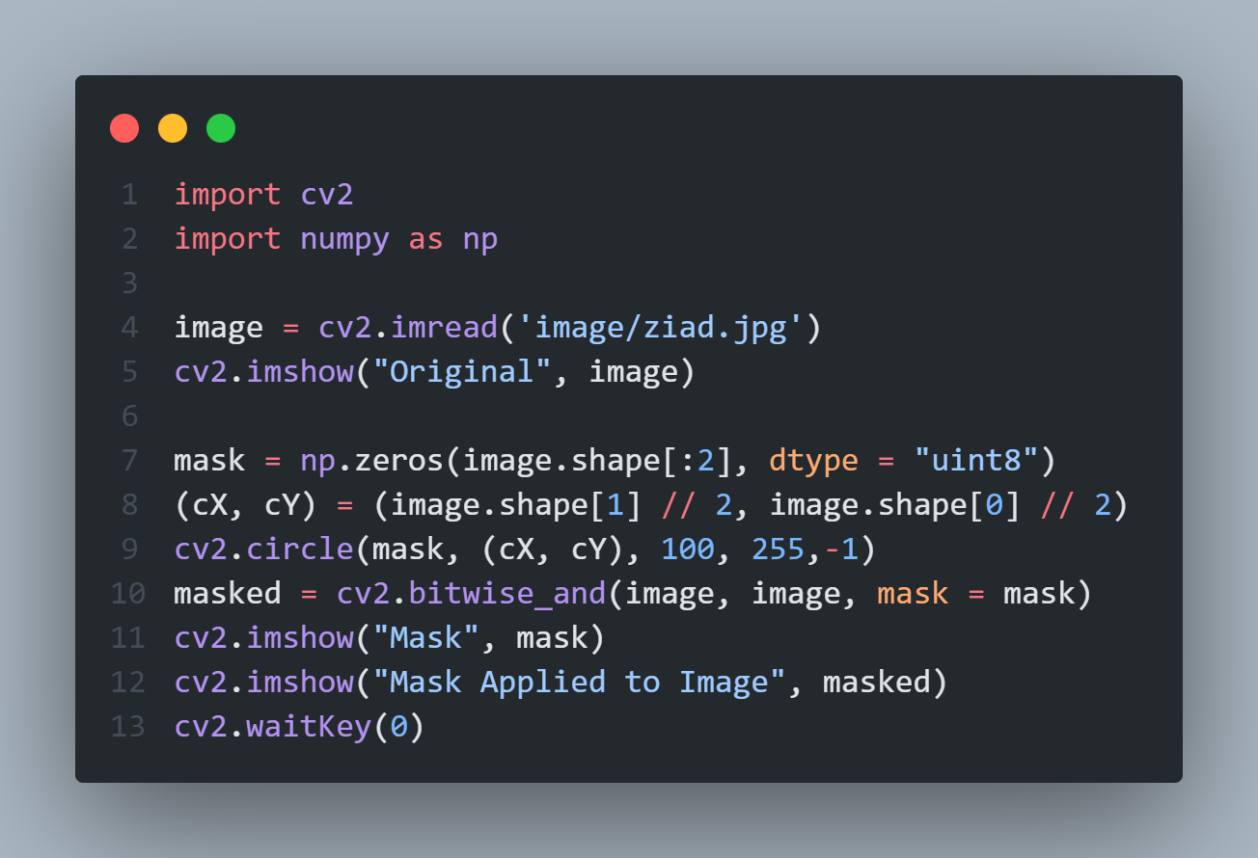
Chapter 6
- Masking circle:

Slide 18
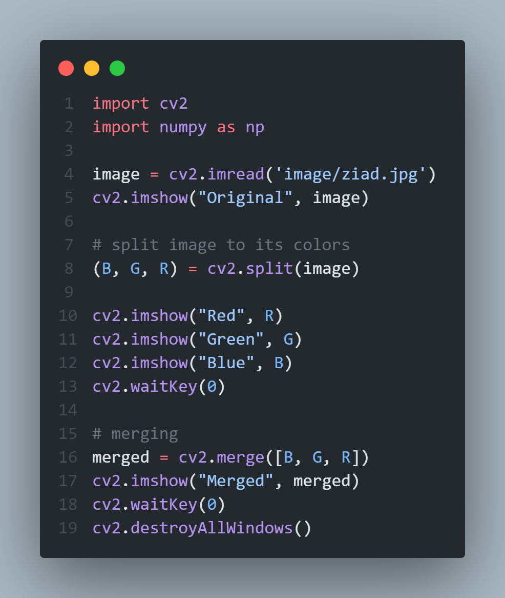
Chapter 6
- Splitting and merging channels:

Slide 19
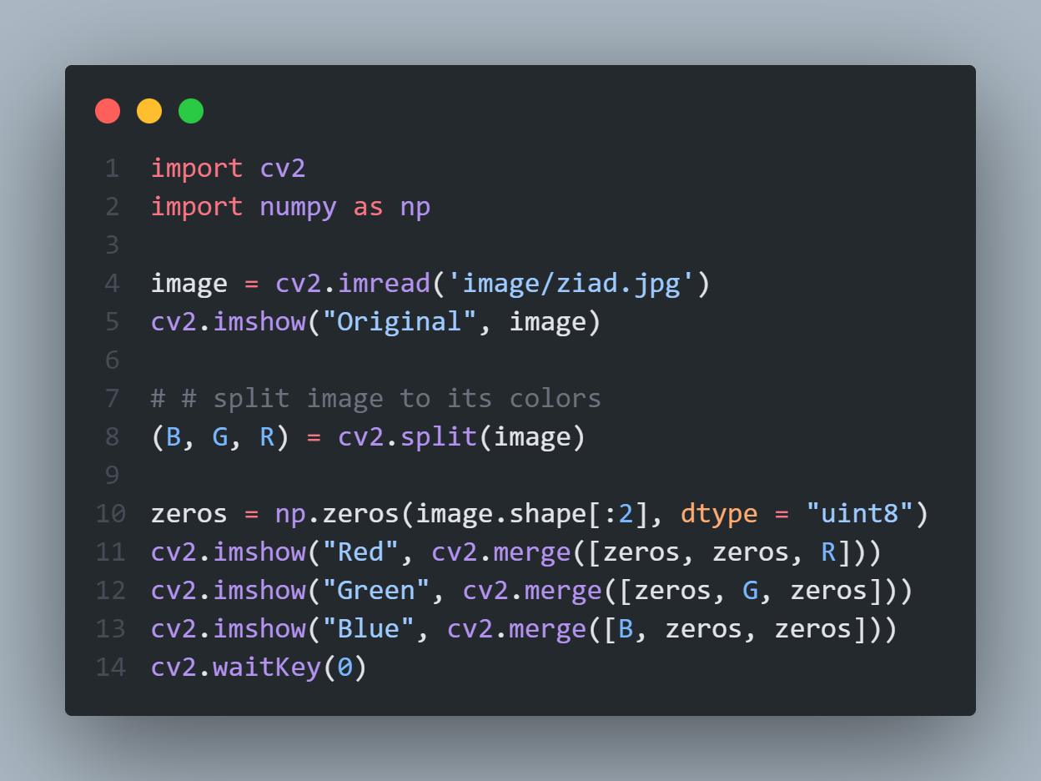
Chapter 6
Spliting:

Slide 20
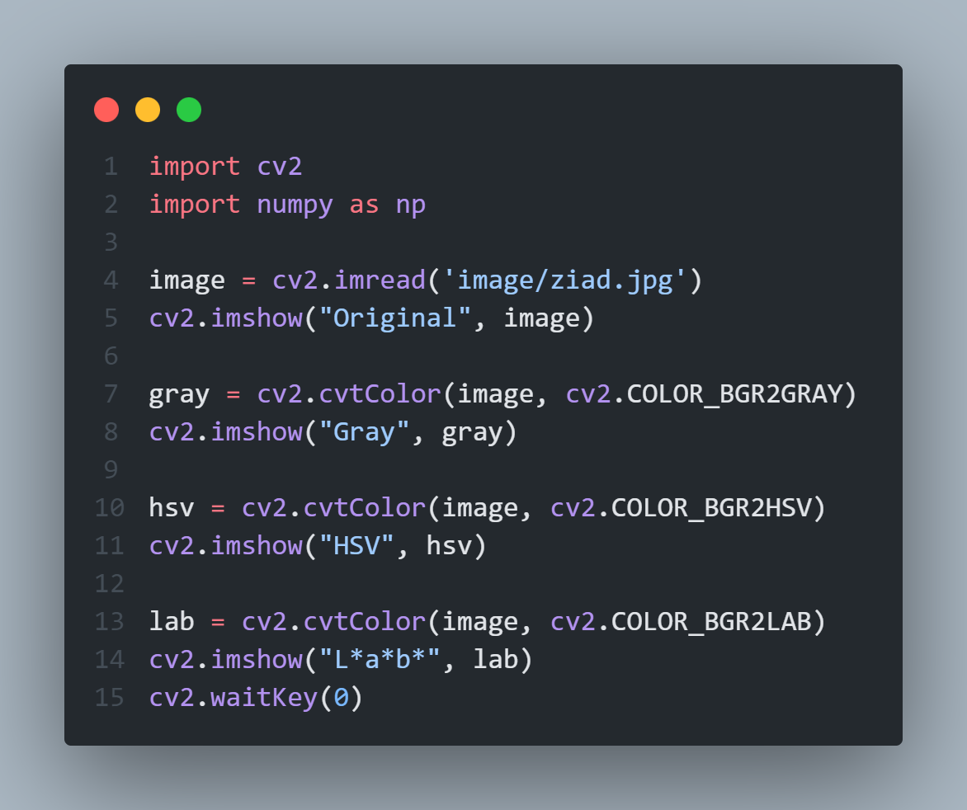
Chapter 6
- Color spaces:

Slide 21
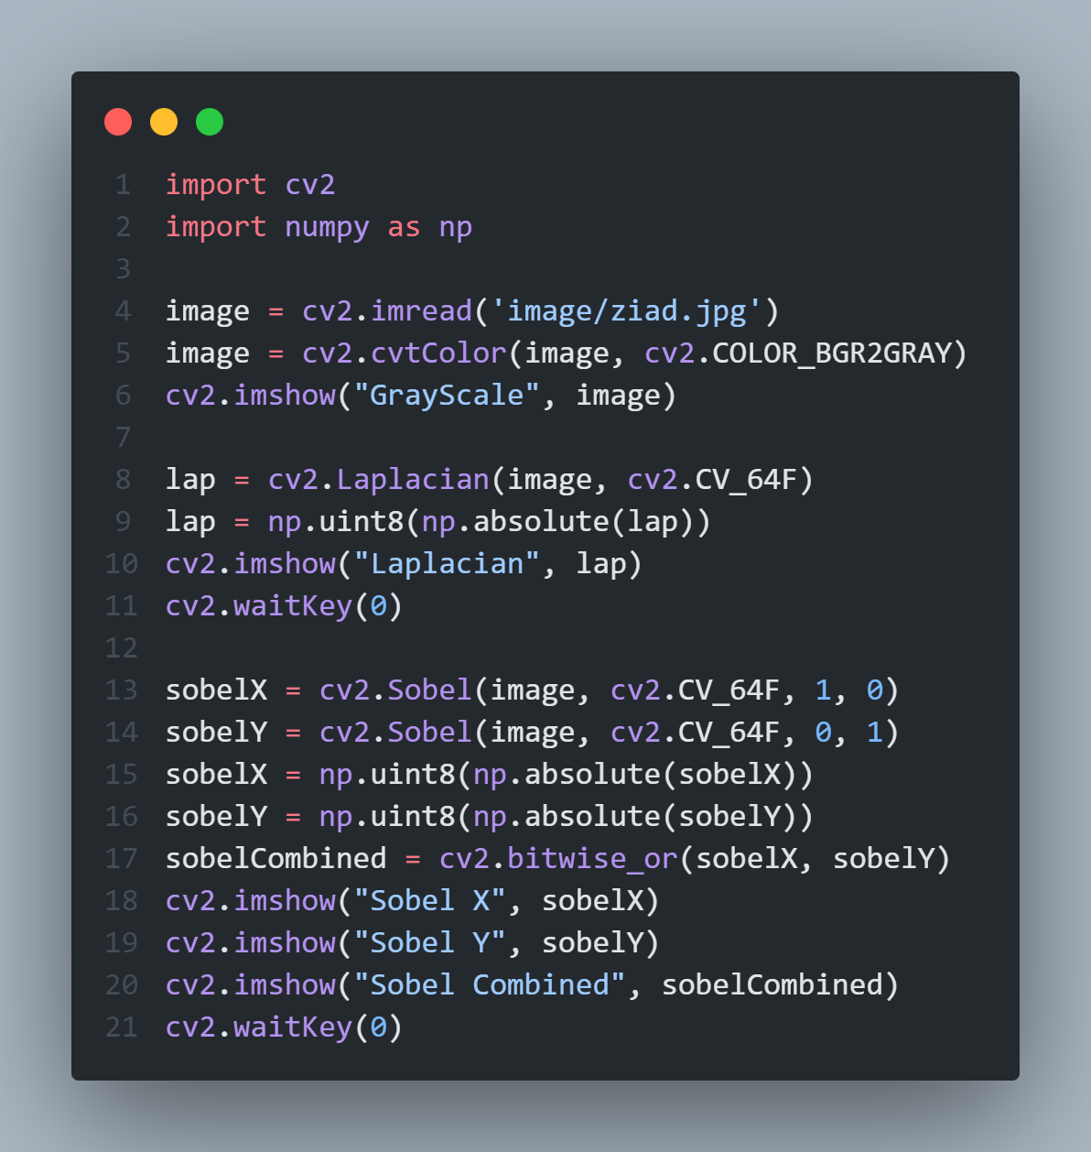
Chapter 10
- Laplacian and Sobel:

Slide 22
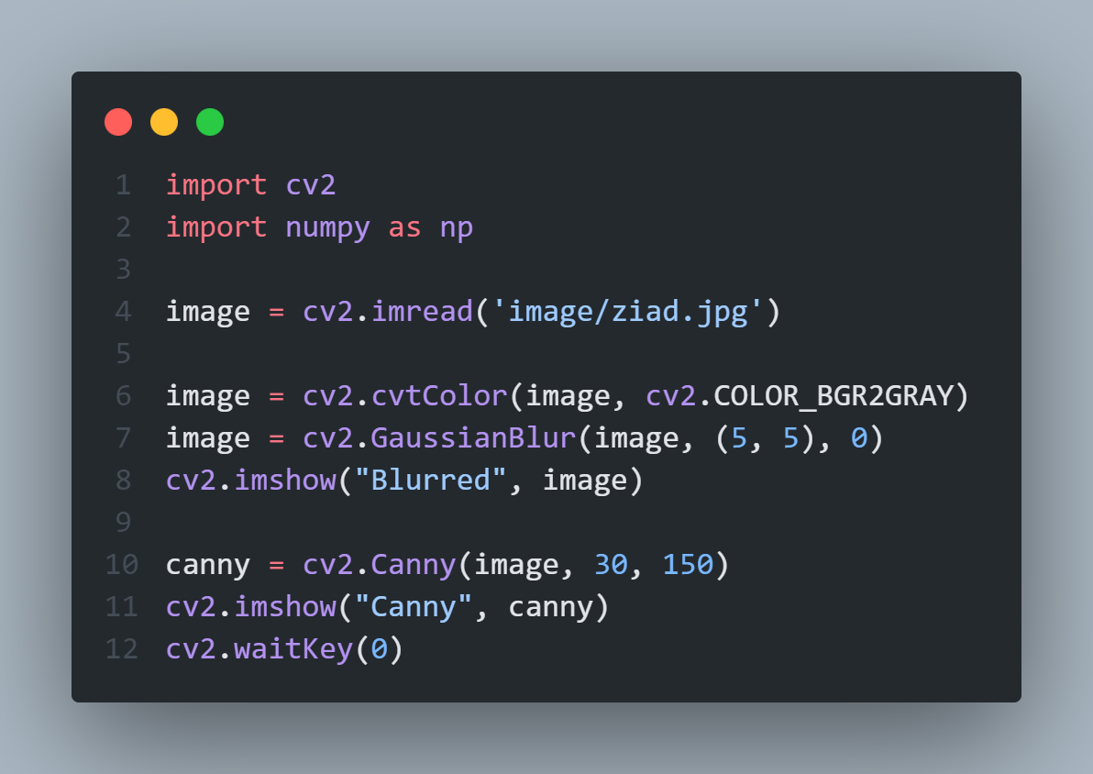
Chapter 10
- Canny:

Slide 23

Thanks

